Slide 1
Explore Texas History:
Nothing But Net!
Roger Palmer
Anita Palmer
GISetc
roger@gisetc.com
anita@gisetc.com
www.gisetc.com

Slide 2
GIS is...
Geographic
Information
Systems
www.gis.com

Slide 3
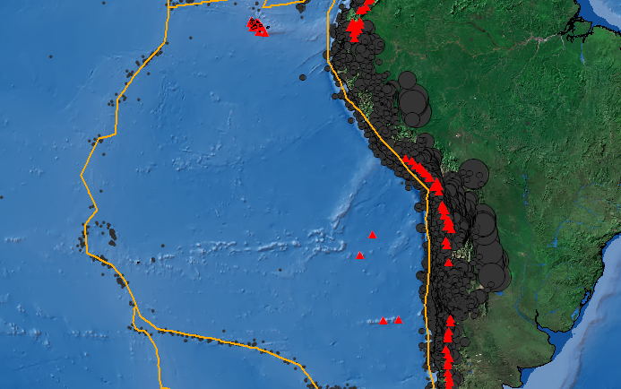
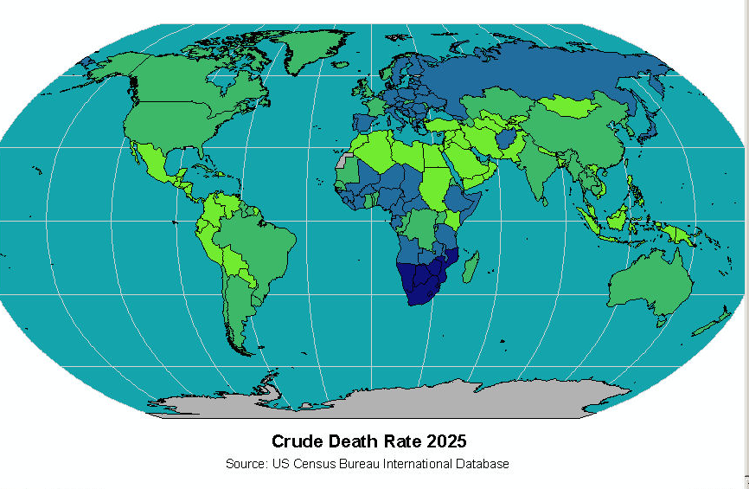
GIS involves
Information about the world
Represented by points, lines, areas, and images
At any scale from global, to regional, to local
Exploring interactive concepts on computer

Slide 4
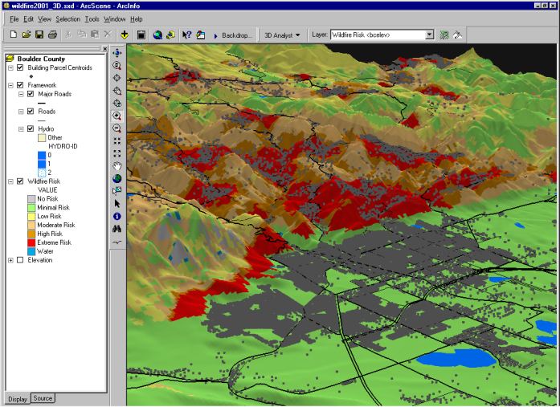
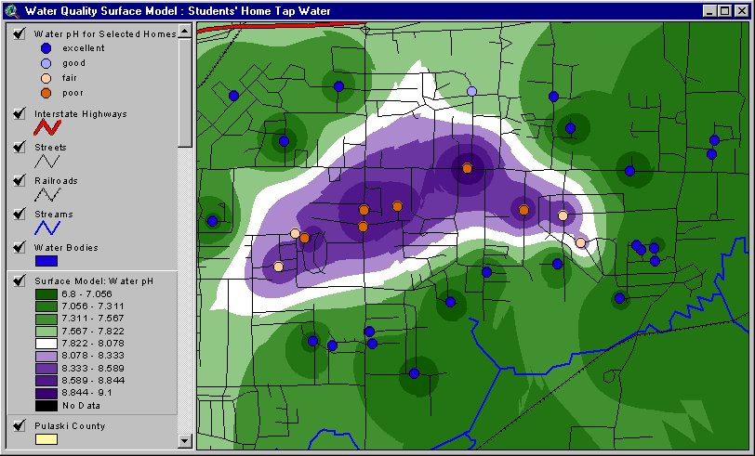
GIS performs key activities
Visualizing spatial information...“making maps”
Manipulating and analyzing spatial information...“asking questions of the maps and data”

Slide 5
GIS a tool continuum for education
Limited Capacity Web Only Services
Programs streaming Web- Services
Fully Functional Desktop web enhanced
Education settings demand more than a “one size fits all” approach.
ESRI and partners are moving on all fronts

Slide 6
GIS solutions for education:
Geospatial tool examples
Limited
Capacity
Tailored
Full Functionality
ArcGIS Explorer
ArcGIS
Web Mapping,
ArcGISonline
Range of ESRI Web-based services

Slide 7
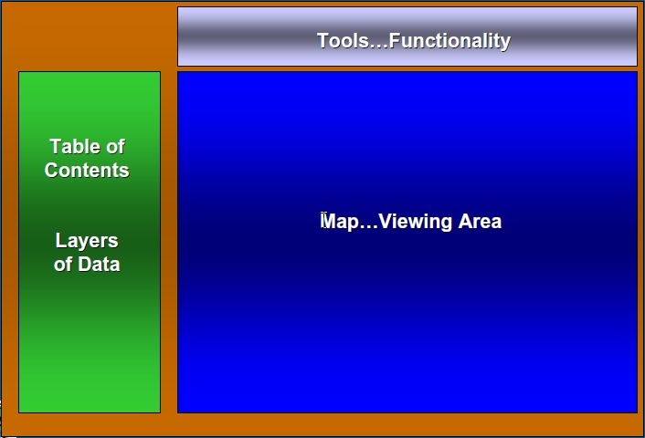
Typical Webmap Interface

Slide 8
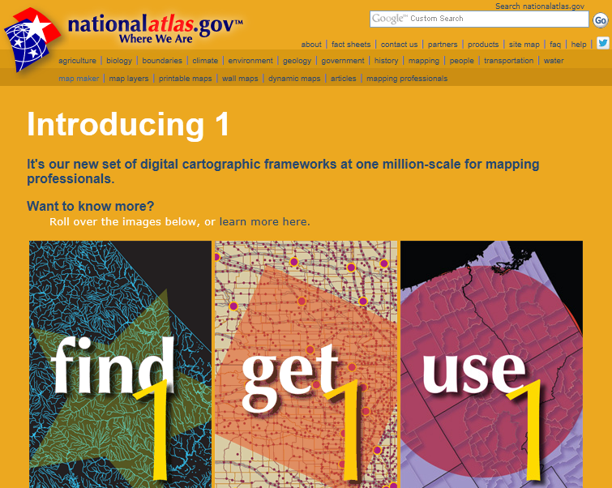
NationalAtlas.gov

Slide 9
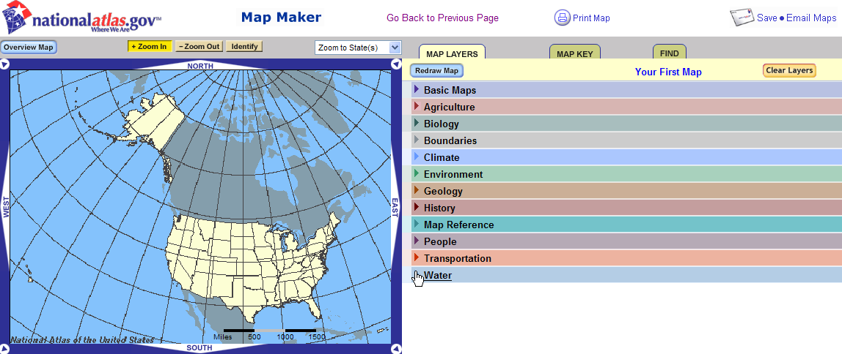

Slide 10

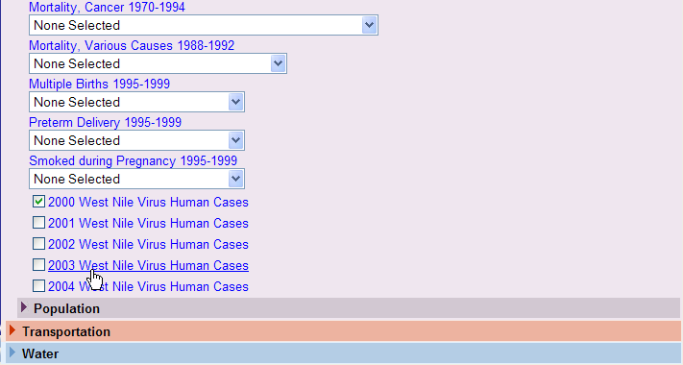
Following Disease and Sickness

Slide 11
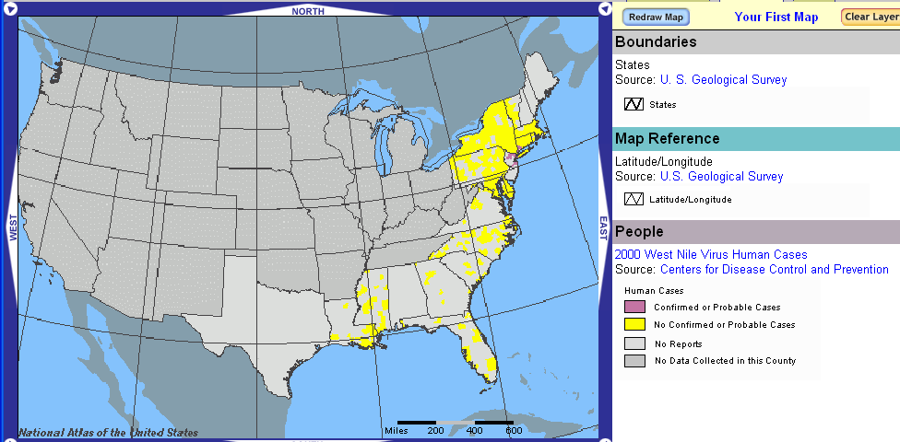
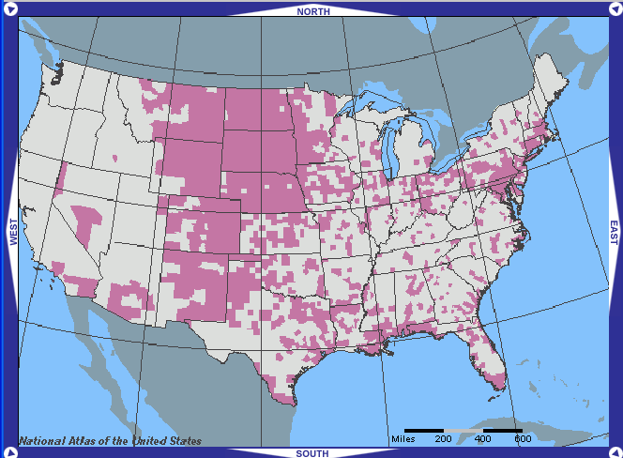
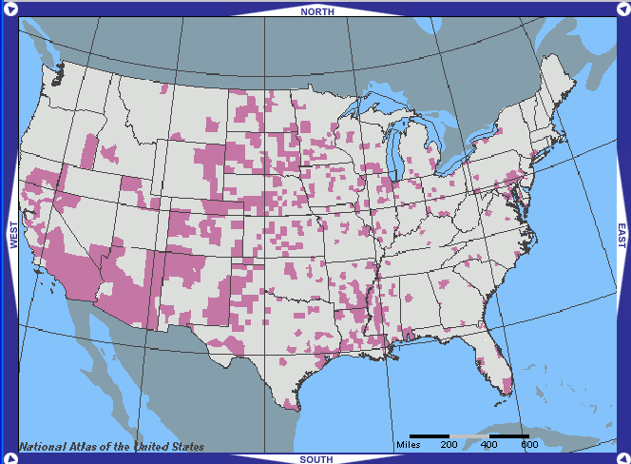
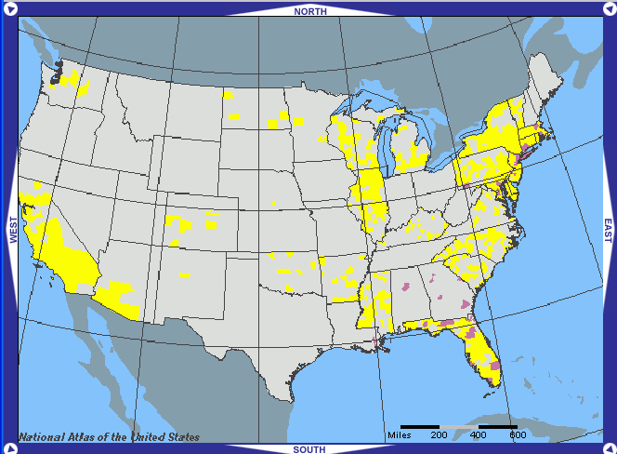
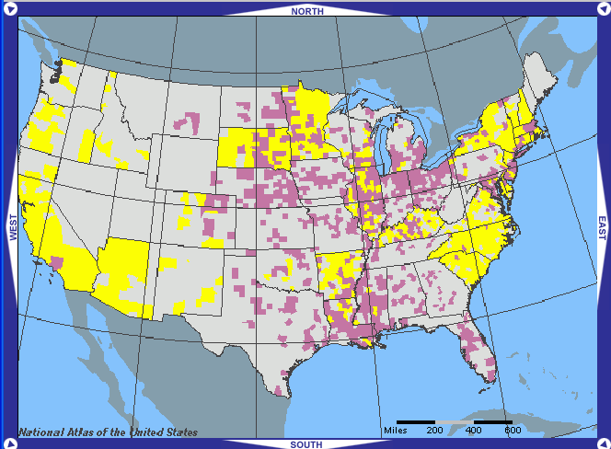
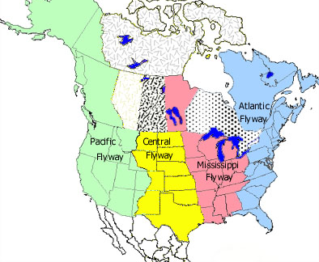
2000
2003
2004
2001
2002

Slide 12
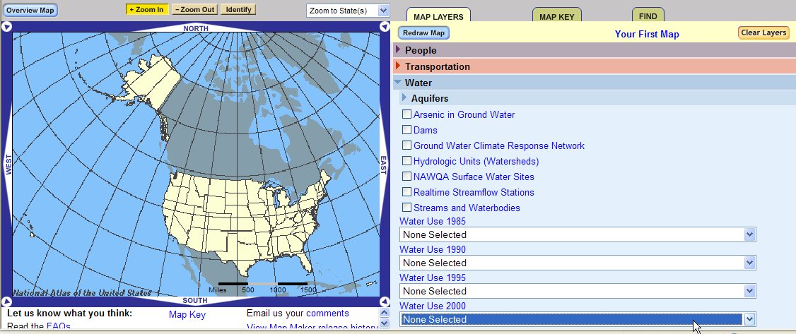
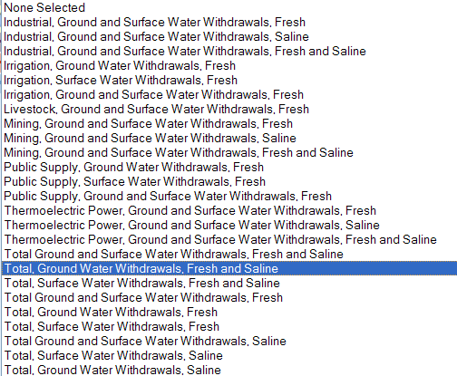
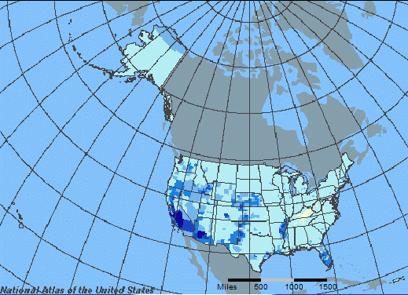
Finding Natural Resources: Ground Water

Slide 13
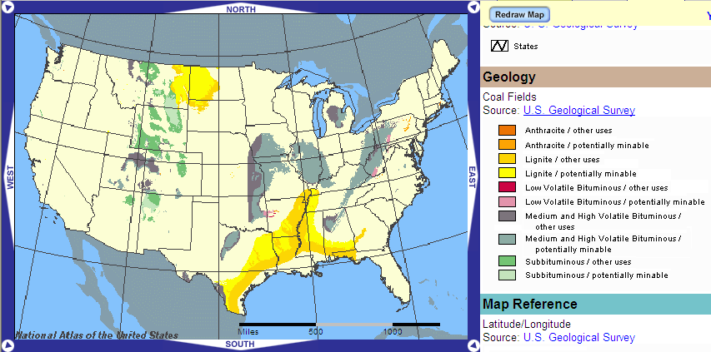
Finding Natural Resources: Coal

Slide 14
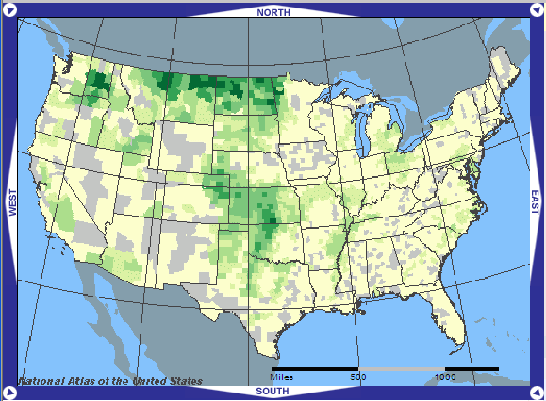
Understanding Texas Regions:
Wheat

Slide 15
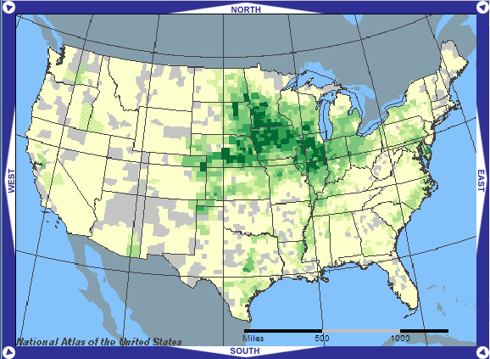
Understanding Texas Regions:
Corn

Slide 16

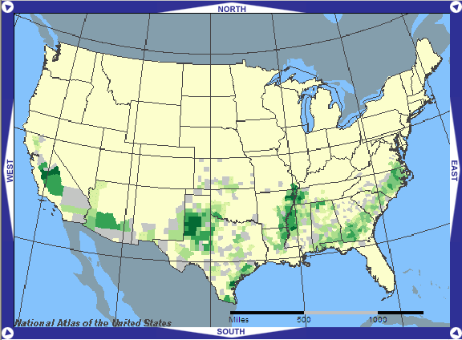
Cotton

Slide 17
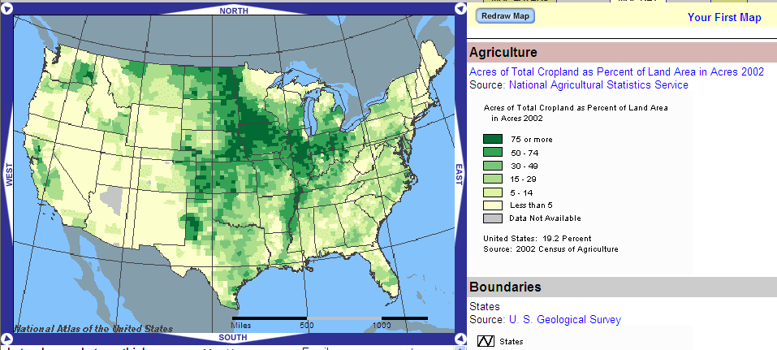
Total Agriculture

Slide 18
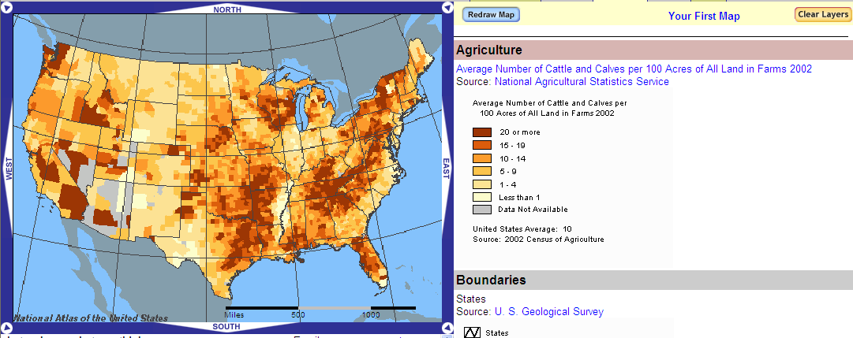
Cattle per Acre

Slide 19
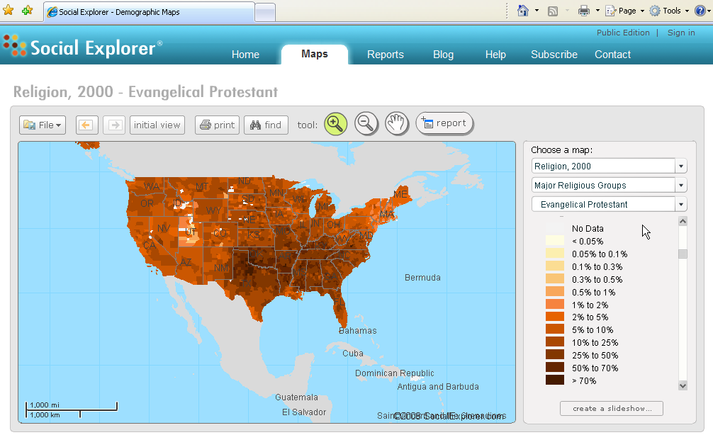
www.socialexplorer.com

Slide 20
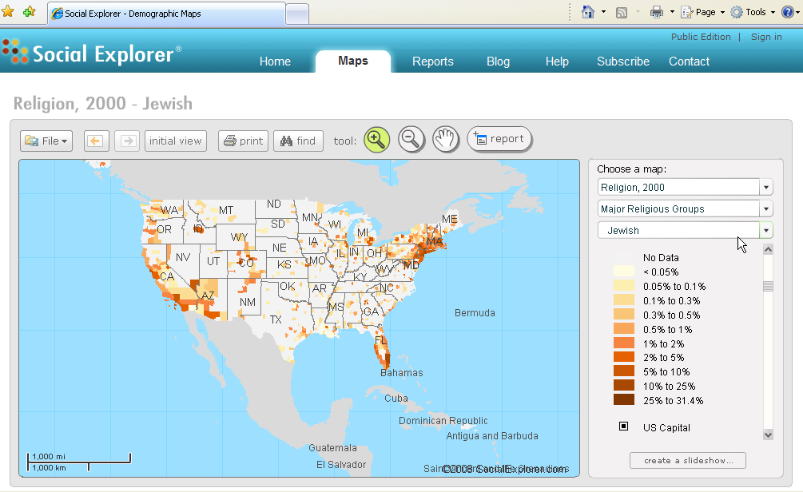

Slide 21
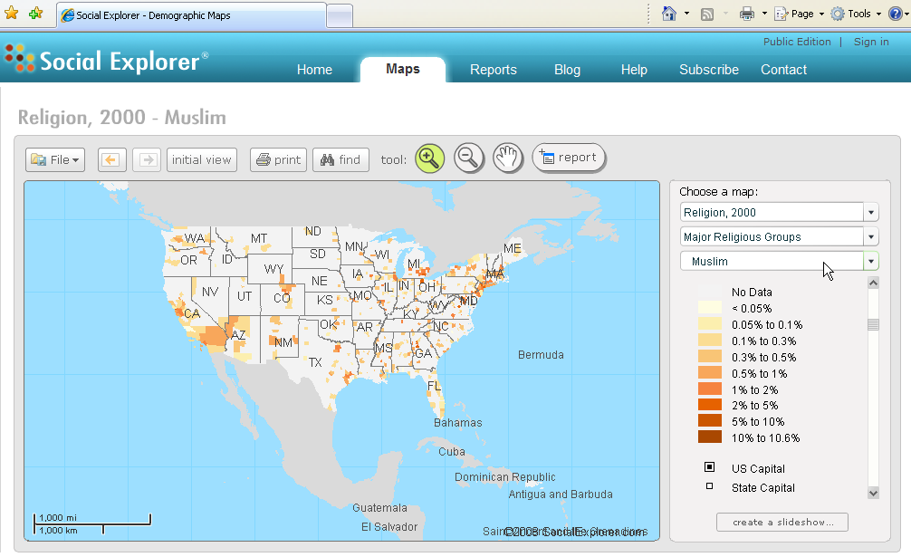

Slide 22
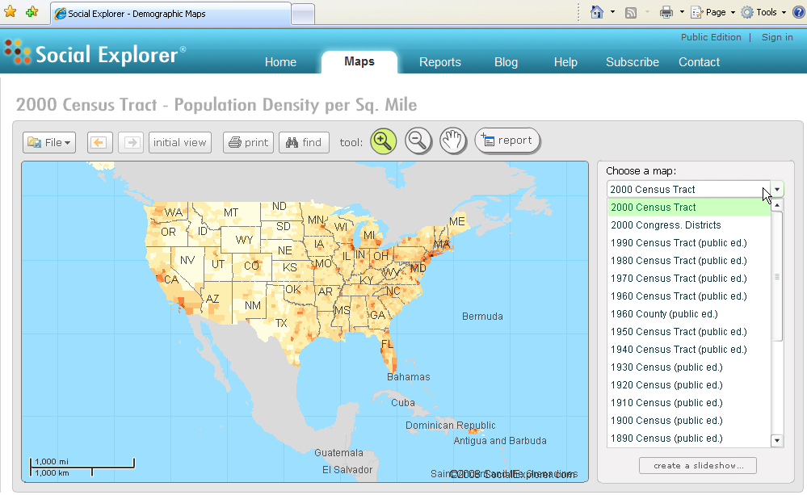

Slide 23
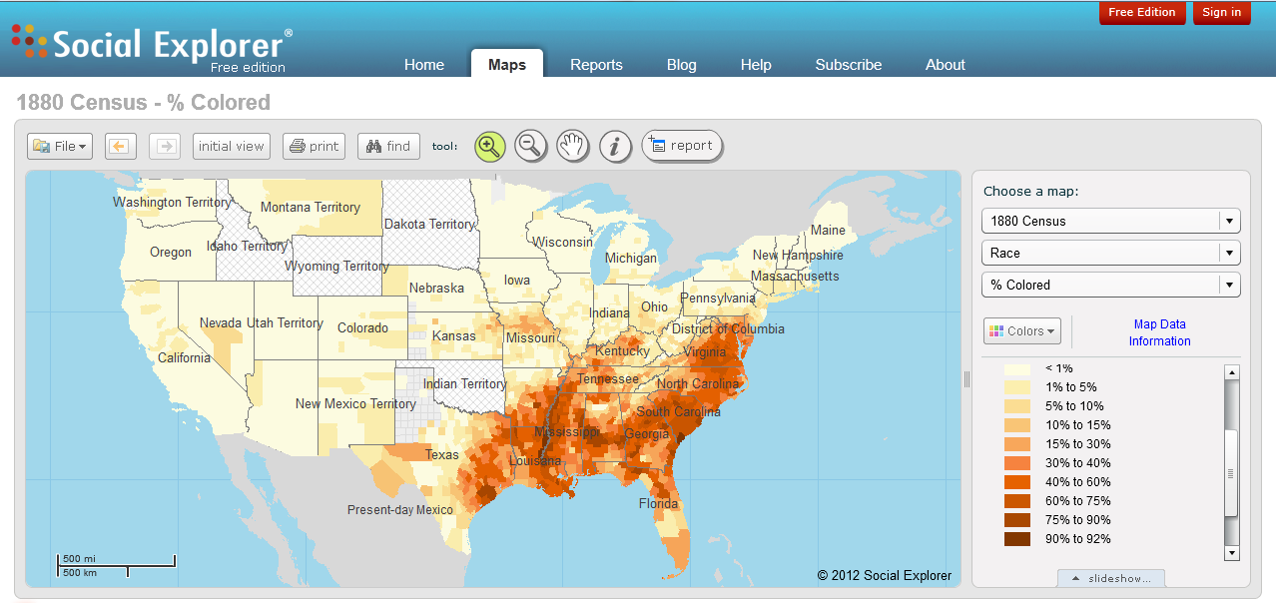
How did the Civil War change ethnic distribution?

Slide 24
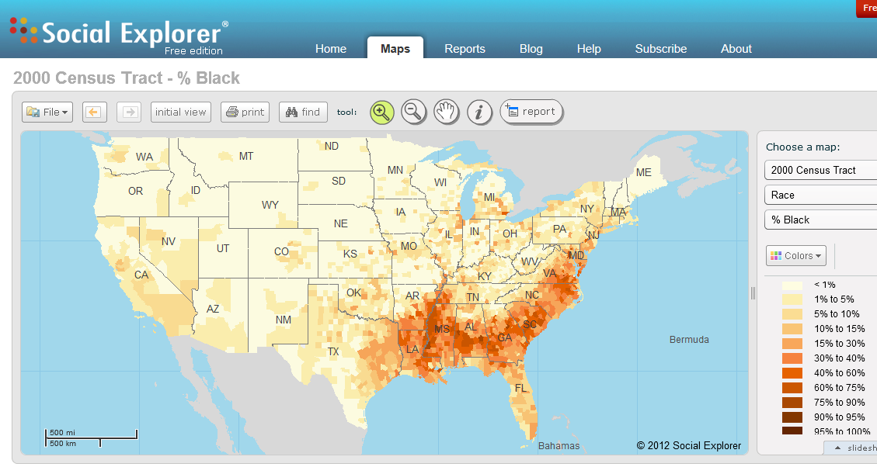
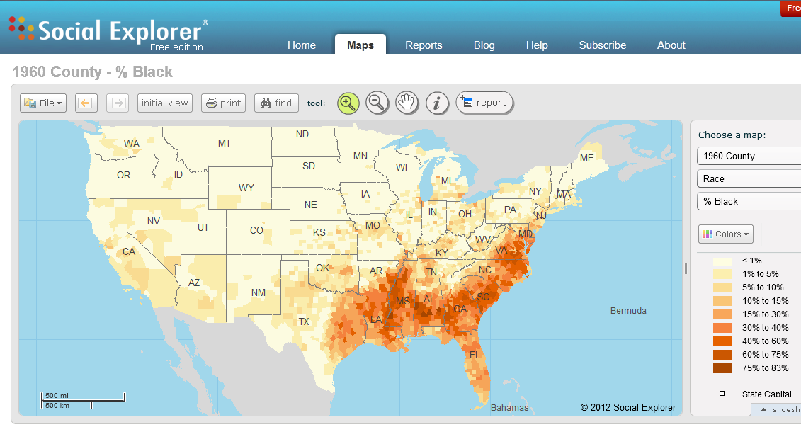
How about the right to vote?

Slide 25
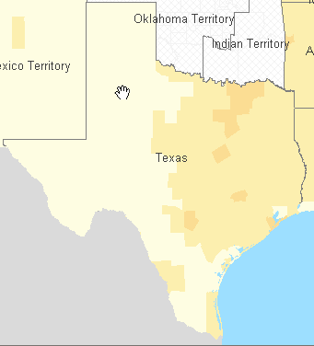
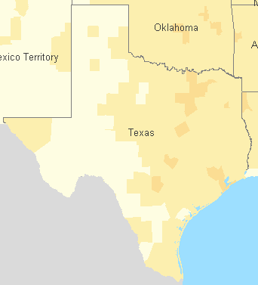
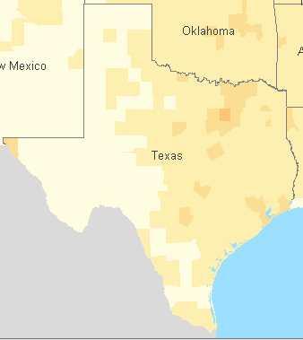
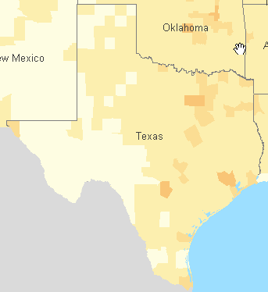
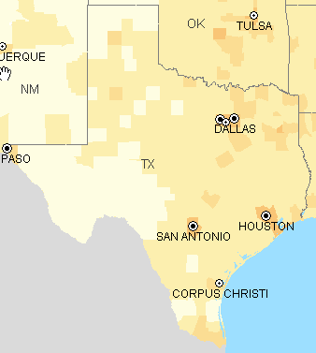
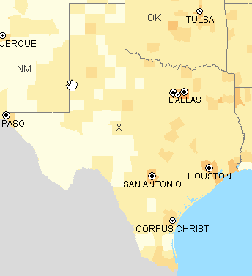
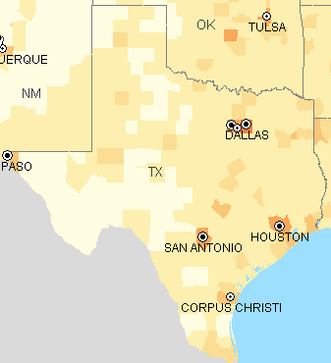
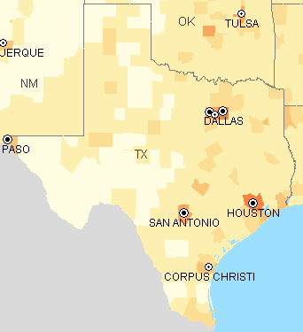
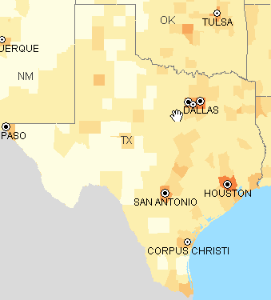
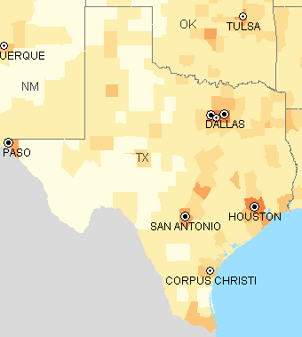
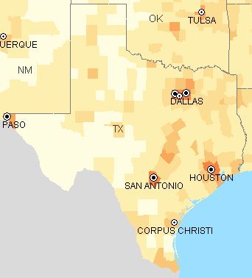
1900
1910
1920
1930
1940
1950
1960
1970
How has
Texas changed
in boom and
busts?
(Population Density)
1980
1990
2000

Slide 26
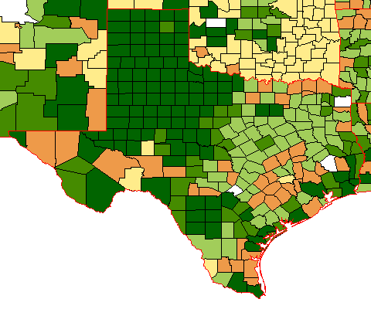
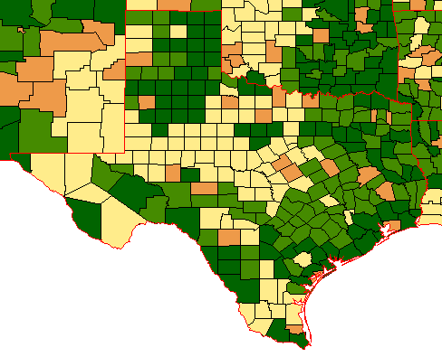
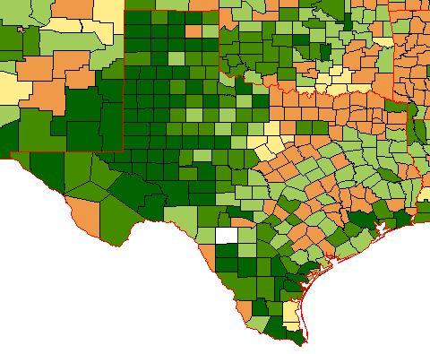
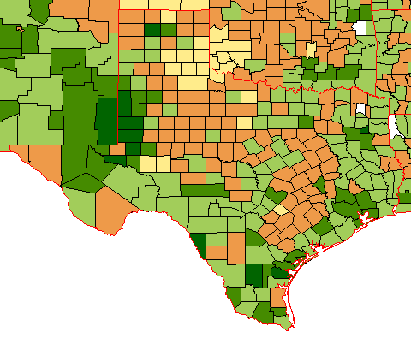
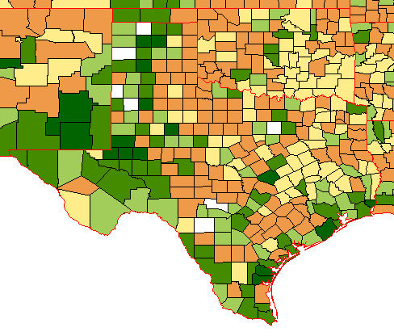
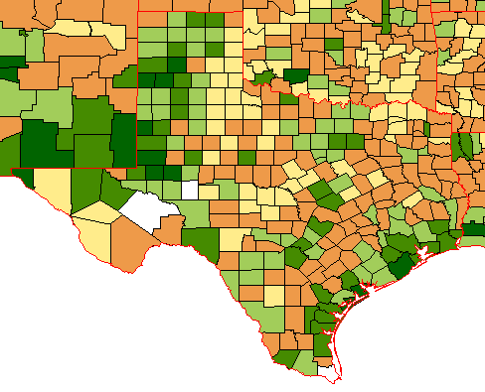
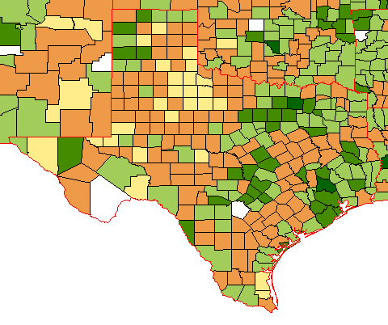
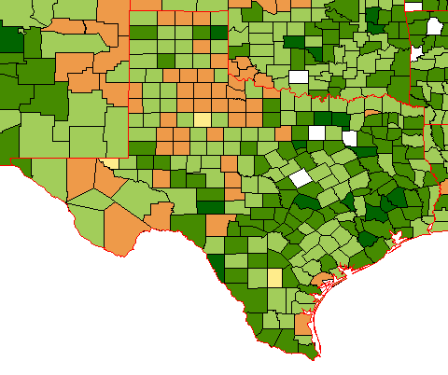
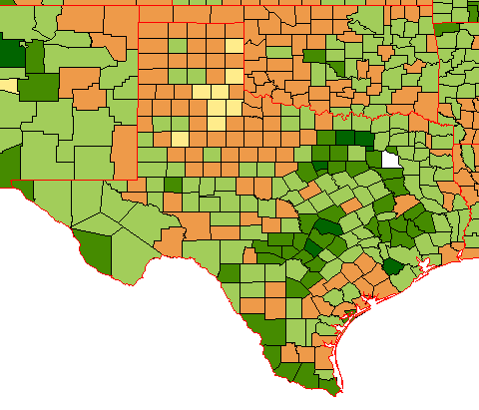
Using the data in desktop GIS shows patterns of county growth (green) or loss (tan) even better
1900s
1910s
1920s
1930s
1940s
1960s
1970s
1980s
1990s

Slide 27

fisher.lib.virginia.edu/collections/stats/histcensus/

Slide 28


Slide 29



Slide 30







Money invested in manufacturing
1840, 1850, 1860, 1870, 1880, 1890, 1900

Slide 31



Slide 32


Slide 33


Slide 34


Slide 35


Slide 36


Slide 37

Current interstate migration

Slide 38





Other places you can learn more about teaching
with GIS in your classroom?
GEO
Feb 6-8 Austin
Arcgis.com/home
Watch the featured
videos links!
Feb 28 – Mar2
Bishop Dunne School
www.bdhs.org/geotech
Hands on workshops!

Slide 39
Thanks for you interest
Any Questions?
Anita@gisetc.com
Roger@gisetc.com

